Slide 1

EV Charging Point Stops
What to do while you wait?
Vuyo D Ndayi

Slide 2

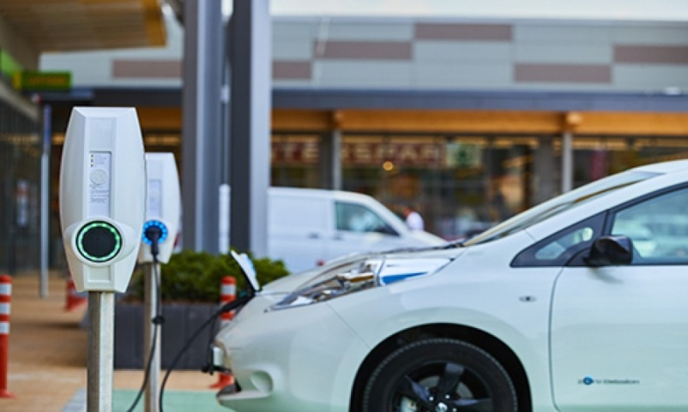
Finding venues near EV charging point stops
Growth in the electric vehicle (EV) market
Development of public charging point infrastructure
Average charging time of EV’s still far exceeds fuel filling rate of internal combustion engine vehicles
How should EV users spend their time while waiting for vehicle to charge on public roads?
Typical EV charging point

Slide 3
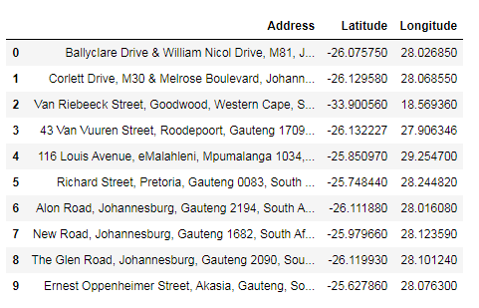
EV charging points across South Africa (RSA)
Create a basic database of EV charging points
Get the address location coordinates
Find venues within walking distance (± 200 m)
Charging point addresses and coordinates (header summary)

Slide 4
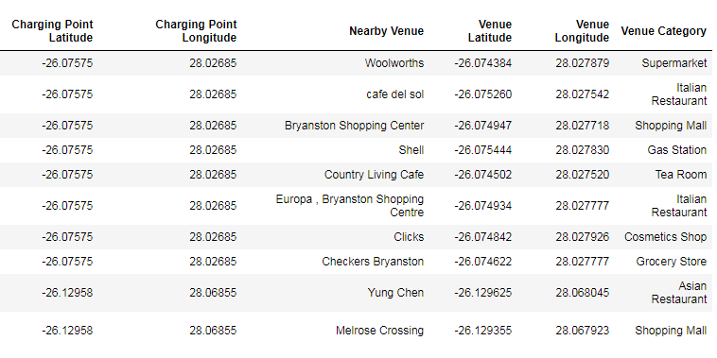
Venues nearby charging points in RSA
Venues within 200 m radius of each charging point
Venue location coordinates and type/category
Venue location coordinates and category (header summary)

Slide 5
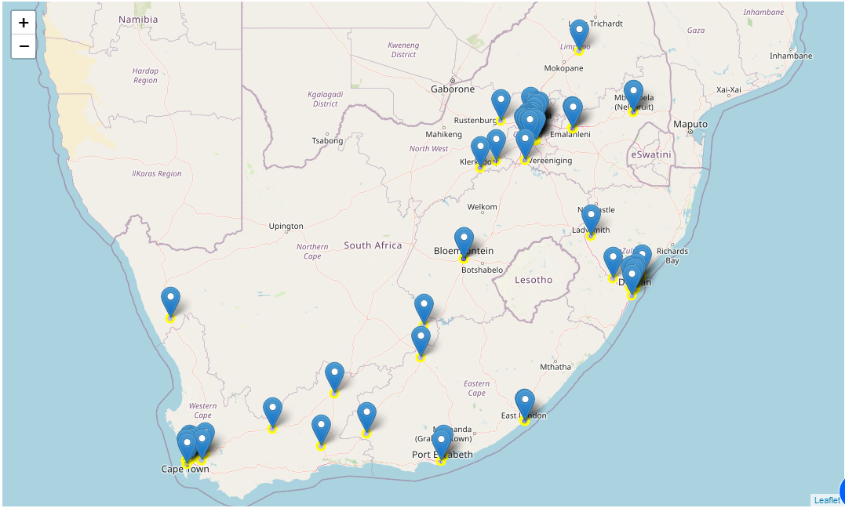
Mapping the charging points in RSA
Charging plug point locations marked on interactive map
Facilitates EV user trip planning
EV charging point location markers on the RSA map

Slide 6
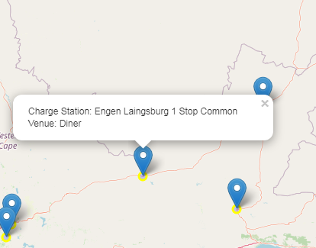
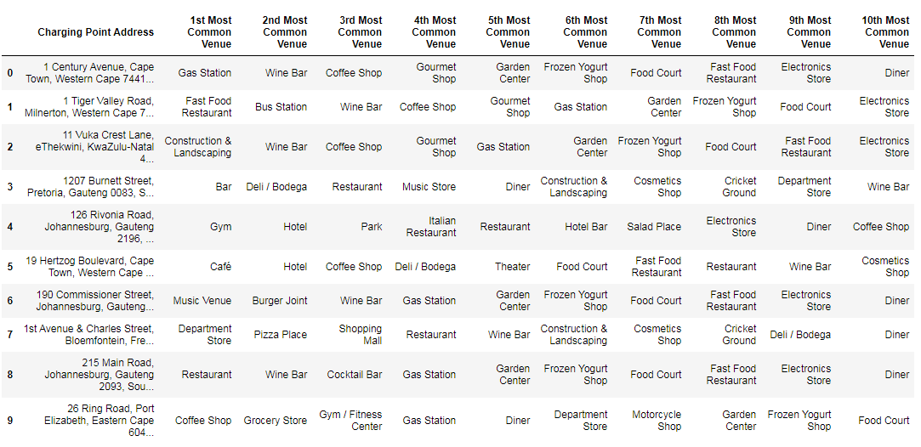
Common venue types near EV charging point
Most common venue type near the charging point is added to the location marker label
Provides a quick overview of the types of amenities nearby
a) Charging point location marker label
b) Most common venues near a specific charging point (header summary

Slide 7
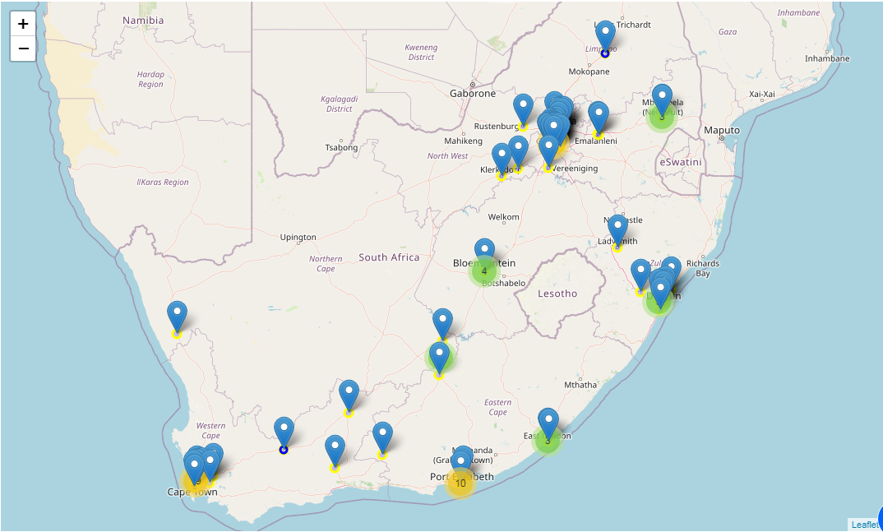
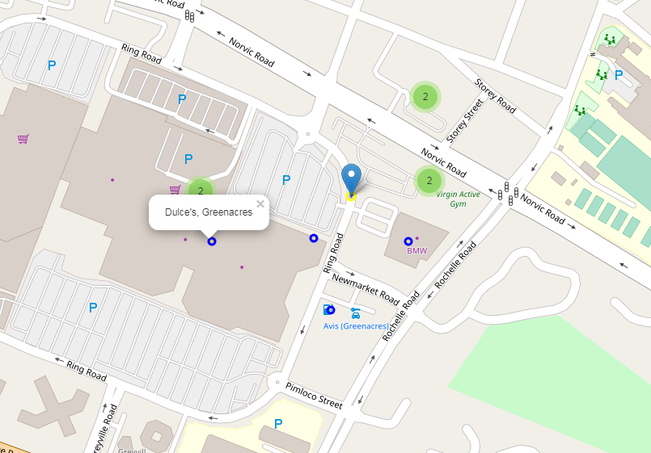
Venue clusters near EV charging point
Venues within a 200 m radius of a charging point are clustered around the marker
Provides a quick overview of the number of venues near the point
a) Clustered venues shown in number groups near the charging point
b) Close-up view of nearby venue marker and label

Slide 8

Further work required for practical application
Additional details on charging point itself e.g. plug point type, usage history, current status
Similar info provided by existing EV charging point location service providers e.g. plugshare.com
Regularly updated information on EV plug point locations
Mobile access platform

